Slide 1
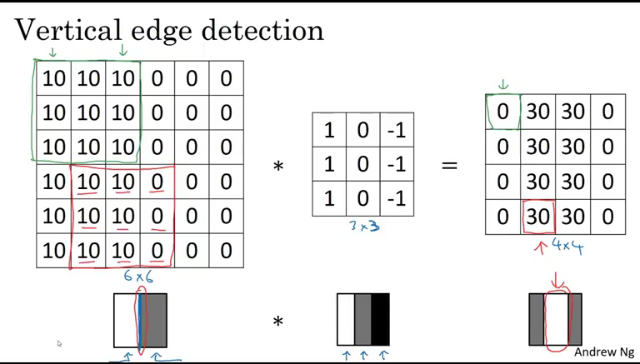
A06 ITAI 1378 Manual CNN
Binary Brains:
Ambalika
Favour
Misty
*Please mute computer as the screen recording picked up external sounds-> sorry*
This Photo by Unknown author is licensed under CC BY-NC.

Slide 2
Step 1
0 | 0 | 0 | 3 | 2 | 0 | 0 | 0
0 | 0 | 0 | -1 | -3 | 0 | 0 | 0
0 | 0 | 0 | 1 | 1 | 0 | 0 | 0
1 | 3 | -3 | -2 | 3 | 2 | 1 | 2
2 | 1 | 1 | -3 | 3 | 1 | 2 | 1
0 | 0 | 0 | 3 | -1 | 0 | 0 | 0
0 | 0 | 0 | 2 | 1 | 0 | 0 | 0
0 | 0 | 0 | -2 | -3 | 0 | 0 | 0
Convolutional Neural Networks (CNN's) is a dep learning model for helping computers understand images.
CNN breaks the image down to smaller parts tries to identify basic features in the image.

Slide 3
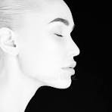
You take an image and the computer will basically place the image in a grid like pictured and will apply filters to that image to convert it

Slide 4
Step 2: Design Filters
Filters/kernels are lenses that slide across the input image to find specific patterns or features.
0 | -1 | 3
2 | 1 | 0
-1 | 2 | 1
0 | 0 | 0
0 | 0 | 0
-1 | 1 | 2
1 | 2 | -1
3 | 0 | -3
-1 | 1 | 0

Slide 5
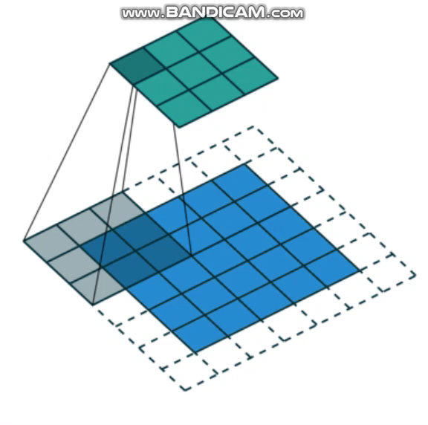
Above is an illustration of a filter/kernel sliding across input data and recording the results in a "pooling layer" template.
Since CNN focuses on the most important aspects, it summarizes information from previous layers and composes a more efficient layer

Slide 6
Step 3: Convolve manually
0 | 0 | 0 | 3 | 2 | 0 | 0 | 0
0 | 0 | 0 | -1 | -3 | 0 | 0 | 0
0 | 0 | 0 | 1 | 1 | 0 | 0 | 0
1 | 3 | -3 | -2 | 3 | 2 | 1 | 2
2 | 1 | 1 | -3 | 3 | 1 | 2 | 1
0 | 0 | 0 | 3 | -1 | 0 | 0 | 0
0 | 0 | 0 | 2 | 1 | 0 | 0 | 0
0 | 0 | 0 | -2 | -3 | 0 | 0 | 0
0 | -1 | 3
2 | 1 | 0
-1 | 2 | 1
Above is an illustration of a CNN layer/kernel sliding across an input image to identify patterns.

Slide 7
Sliding Filters (Kernels):
The convolutional layer employs small filters, also known as kernels or convolutional filters. These filters are small matrices (typically 3x3 or 5x5) that slide or convolve across the input image.
Each filter contains learnable parameters that are adjusted during the training process to detect specific patterns or features.
Feature Detection:
As the filters slide across the input image, they perform element-wise multiplication between their weights and the corresponding pixels in the input image.
The result of this element-wise multiplication is summed up to produce a single value, which represents the activation of the filter at that particular position.
By sliding the filters across the entire input image, the convolutional layer detects various features such as edges, textures, gradients, shapes, and other important patterns.
Receptive Field:
The area covered by the filter as it slides over the input image is called the receptive field.
Initially, the receptive field corresponds to the size of the filter (e.g., 3x3 or 5x5). As the filter slides across the image, the receptive field expands, allowing the network to capture increasingly larger and more complex patterns.

Slide 8
Feature Maps:
The output of applying each filter to the input image is called a feature map.
Each feature map highlights the presence of a specific feature or pattern within the input image.
In practice, a convolutional layer typically consists of multiple filters, each producing its own feature map. These feature maps collectively represent the learned features at that particular layer of the network.
Non-Linearity (Activation Function):
After computing the convolutions, a non-linear activation function (such as ReLU, Sigmoid, or Tanh) is applied element-wise to the feature maps.
The activation function introduces non-linearity into the network, enabling it to learn complex relationships and representations from the input data.
Overall, the convolutional layer plays a crucial role in capturing hierarchical representations of the input data, starting from low-level features (e.g., edges, textures) and gradually progressing to higher-level features (e.g., object parts, object shapes) as the network deepens. This hierarchical feature extraction is essential for the CNN to effectively perform tasks such as image classification, object detection, and segmentation.

Slide 9

Step 4 – Identify Features
Receptive Field: Convolution: (Filter) Destination Pixel:
0 | 0 | 0 | 3 | 2 | 0 | 0 | 0
0 | 0 | 0 | -1 | -3 | 0 | 0 | 0
0 | 0 | 0 | 1 | 1 | 0 | 0 | 0
1 | 3 | -3 | -2 | 3 | 2 | 1 | 2
2 | 1 | 1 | -3 | 3 | 1 | 2 | 1
0 | 0 | 0 | 3 | -1 | 0 | 0 | 0
0 | 0 | 0 | 2 | 1 | 0 | 0 | 0
0 | 0 | 0 | -2 | -3 | 0 | 0 | 0
0 | -1 | 3
2 | 1 | 0
-1 | 2 | 1
 | 0
Algorithm : (0*0)+(0*-1)+(0*0)+
(0*2)+(0*1)+(0*0)+
(0*-1)+(0*2)+(0*1) = 0

Slide 10
Step 4 – Continued
Receptive Field: Convolution: (Filter) Destination Pixel:
0 | 0 | 0 | 3 | 2 | 0 | 0 | 0
0 | 0 | 0 | -1 | -3 | 0 | 0 | 0
0 | 0 | 0 | 1 | 1 | 0 | 0 | 0
1 | 3 | -3 | -2 | 3 | 2 | 1 | 2
2 | 1 | 1 | -3 | 3 | 1 | 2 | 1
0 | 0 | 0 | 3 | -1 | 0 | 0 | 0
0 | 0 | 0 | 2 | 1 | 0 | 0 | 0
0 | 0 | 0 | -2 | -3 | 0 | 0 | 0
0 | -1 | 3
2 | 1 | 0
-1 | 2 | 1
 | 8
Algorithm : (1*0)+(1*-1)+(0*3)+
(-2*2)+(3*1)+(2*0)+
(-3*-1)+(3*2)+(1*1)= 8

Slide 11
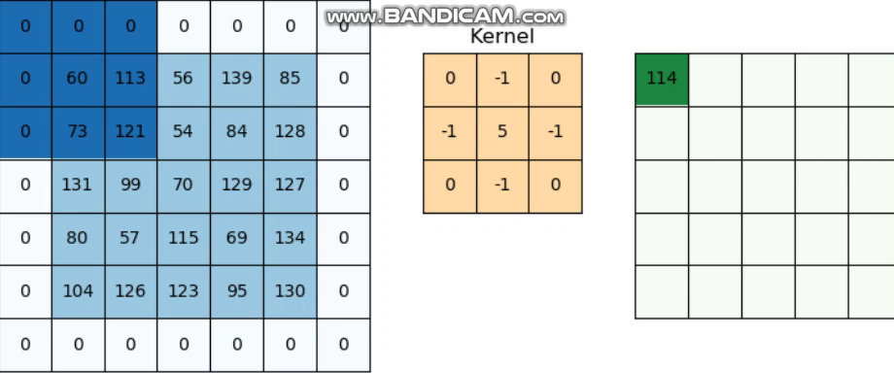

Slide 12
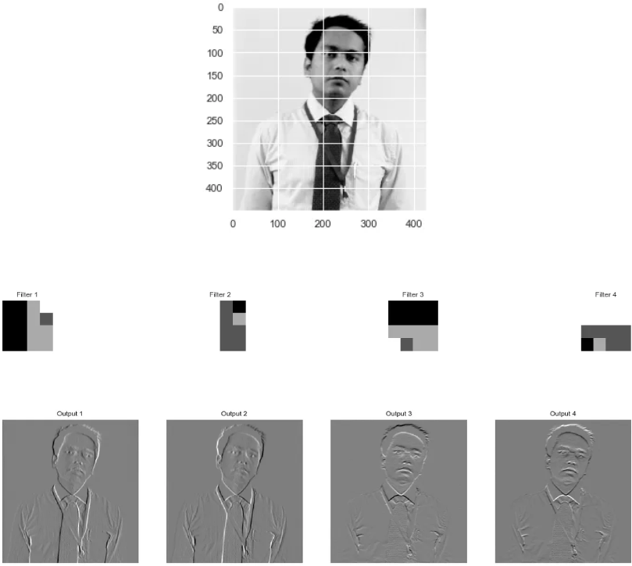
When the filters are applied you are able to manipulate the image based off your desire. You can sharpen or lighten the image, change the colors, etc.

Slide 13
